Slide 2
Mastering SharePoint Framework (PnP tutorial)
November 29, 2021
Microsoft 365 PnP Team

Slide 4


Agenda for today
9:00 – 9:15 – Welcome and introductions - Vesa
9:15 – 10:30 – Overview on SPFx - Vesa
10:15 – 10:30 – Break
10:30 – 12:00 – Building Extensibility for Viva Connections - Paolo
12:00 – 13:00 – Lunch
13:00 – 14:30 – Solution design patterns and learnings on building a product offerings with SharePoint framework – Elio
14:00 – 14:15 – Break
14:15 – 15:15 – Styling and theming with SharePoint Framework – Stefan (remotely)
15:15 – 15:30 – Break
15:30 – 16:15 – More complex scenarios – Azure AD API calls, Graph usage, considerations, DevOps (?) – Paolo & Vesa
16:15 – 17:00 – Roadmap and AMA with Microsoft Engineering - Vesa
Feel free to ask questions during the presentations

Slide 5







Presenters through out the day
Remotely
Elio Struyf
Legend
Struyf Consulting
Stefan Bauer
UX Guru
N8D
Paolo Pialorsi
Senior Consultant
Piasys.com
Vesa Juvonen
Principal Program Manager

Slide 6
STYLING AND & THEMING WITH SHAREPOINT FRAMEWORK
CSS build chain / specifics and changes
Filename conventions
CSS Modules – Responsive Design
CSS custom properties
Theme Slots / Color Slots / Design Tokens
hTWOo – Flexible Fluent UI Framework
AKA

Slide 7
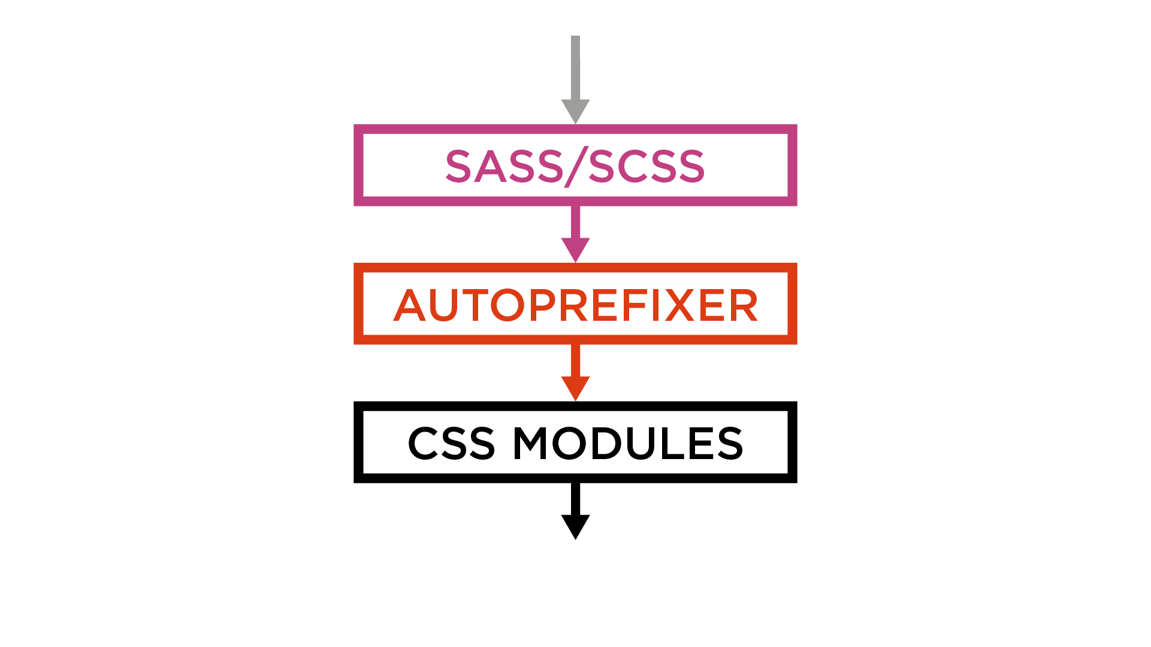

Slide 8
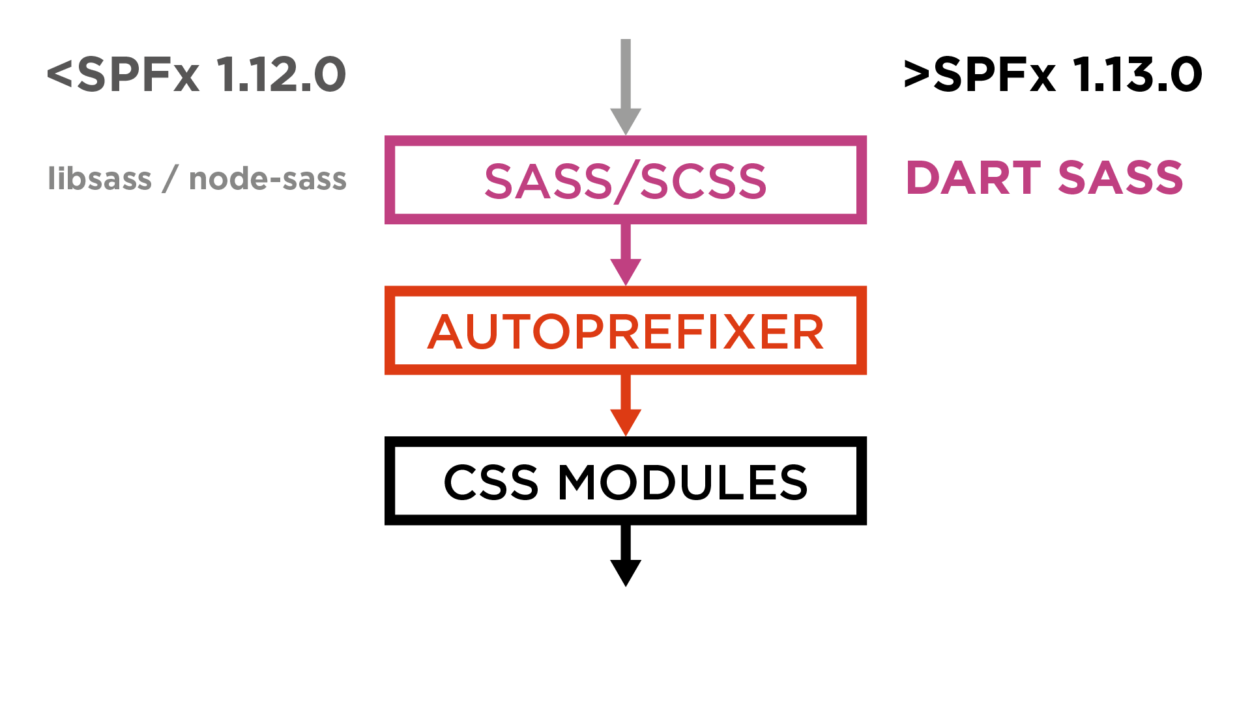

Slide 9
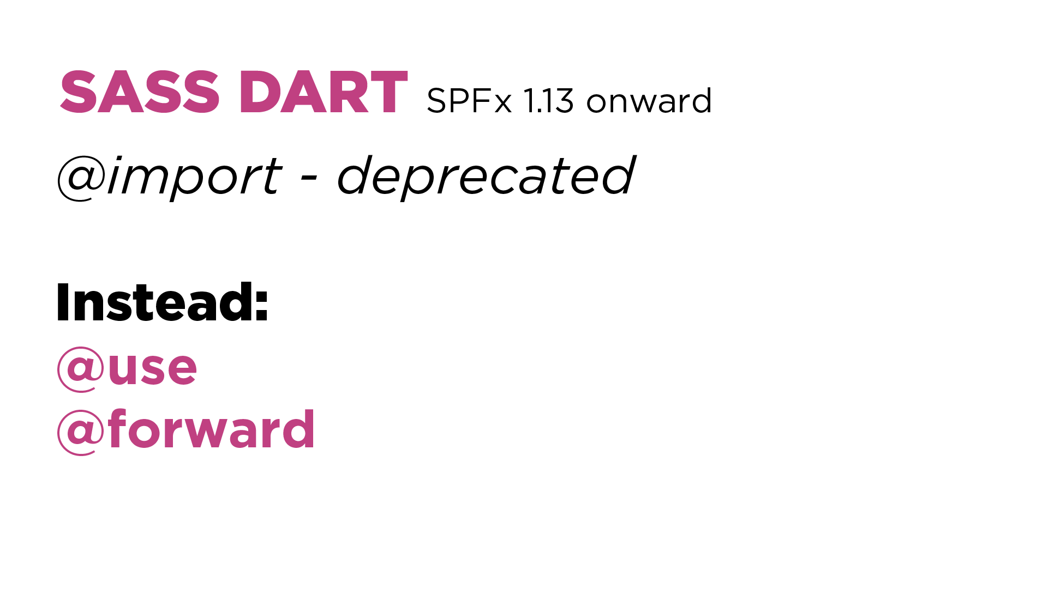

Slide 10
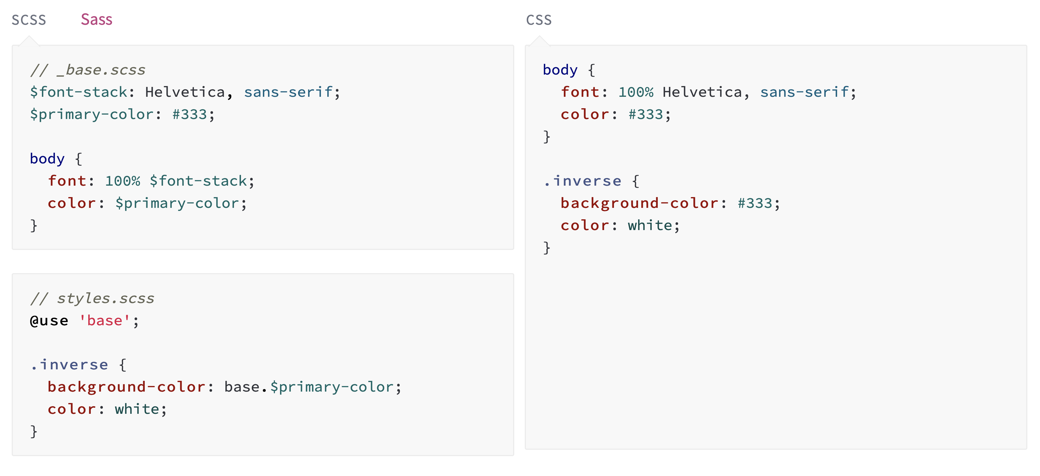
https://sass-lang.com/documentation/at-rules/use

Slide 11
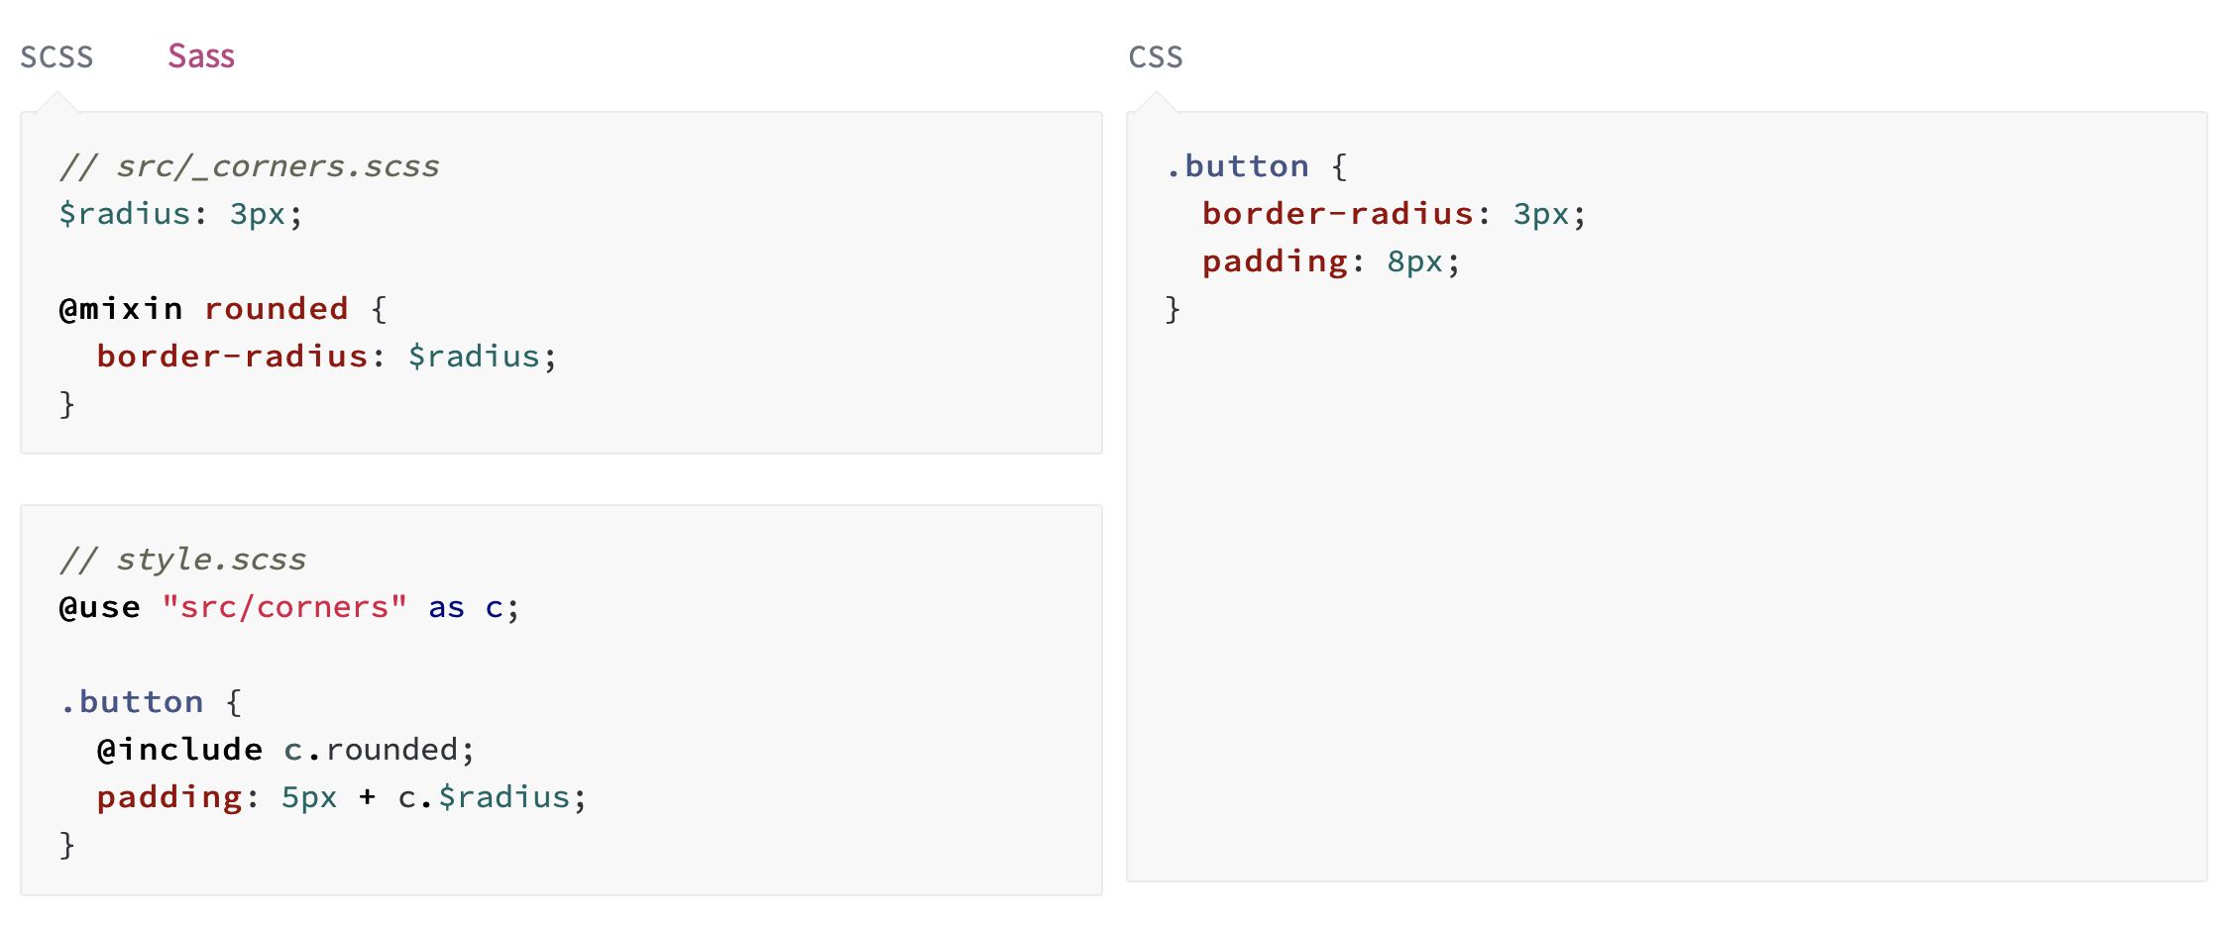
https://sass-lang.com/documentation/at-rules/use

Slide 12
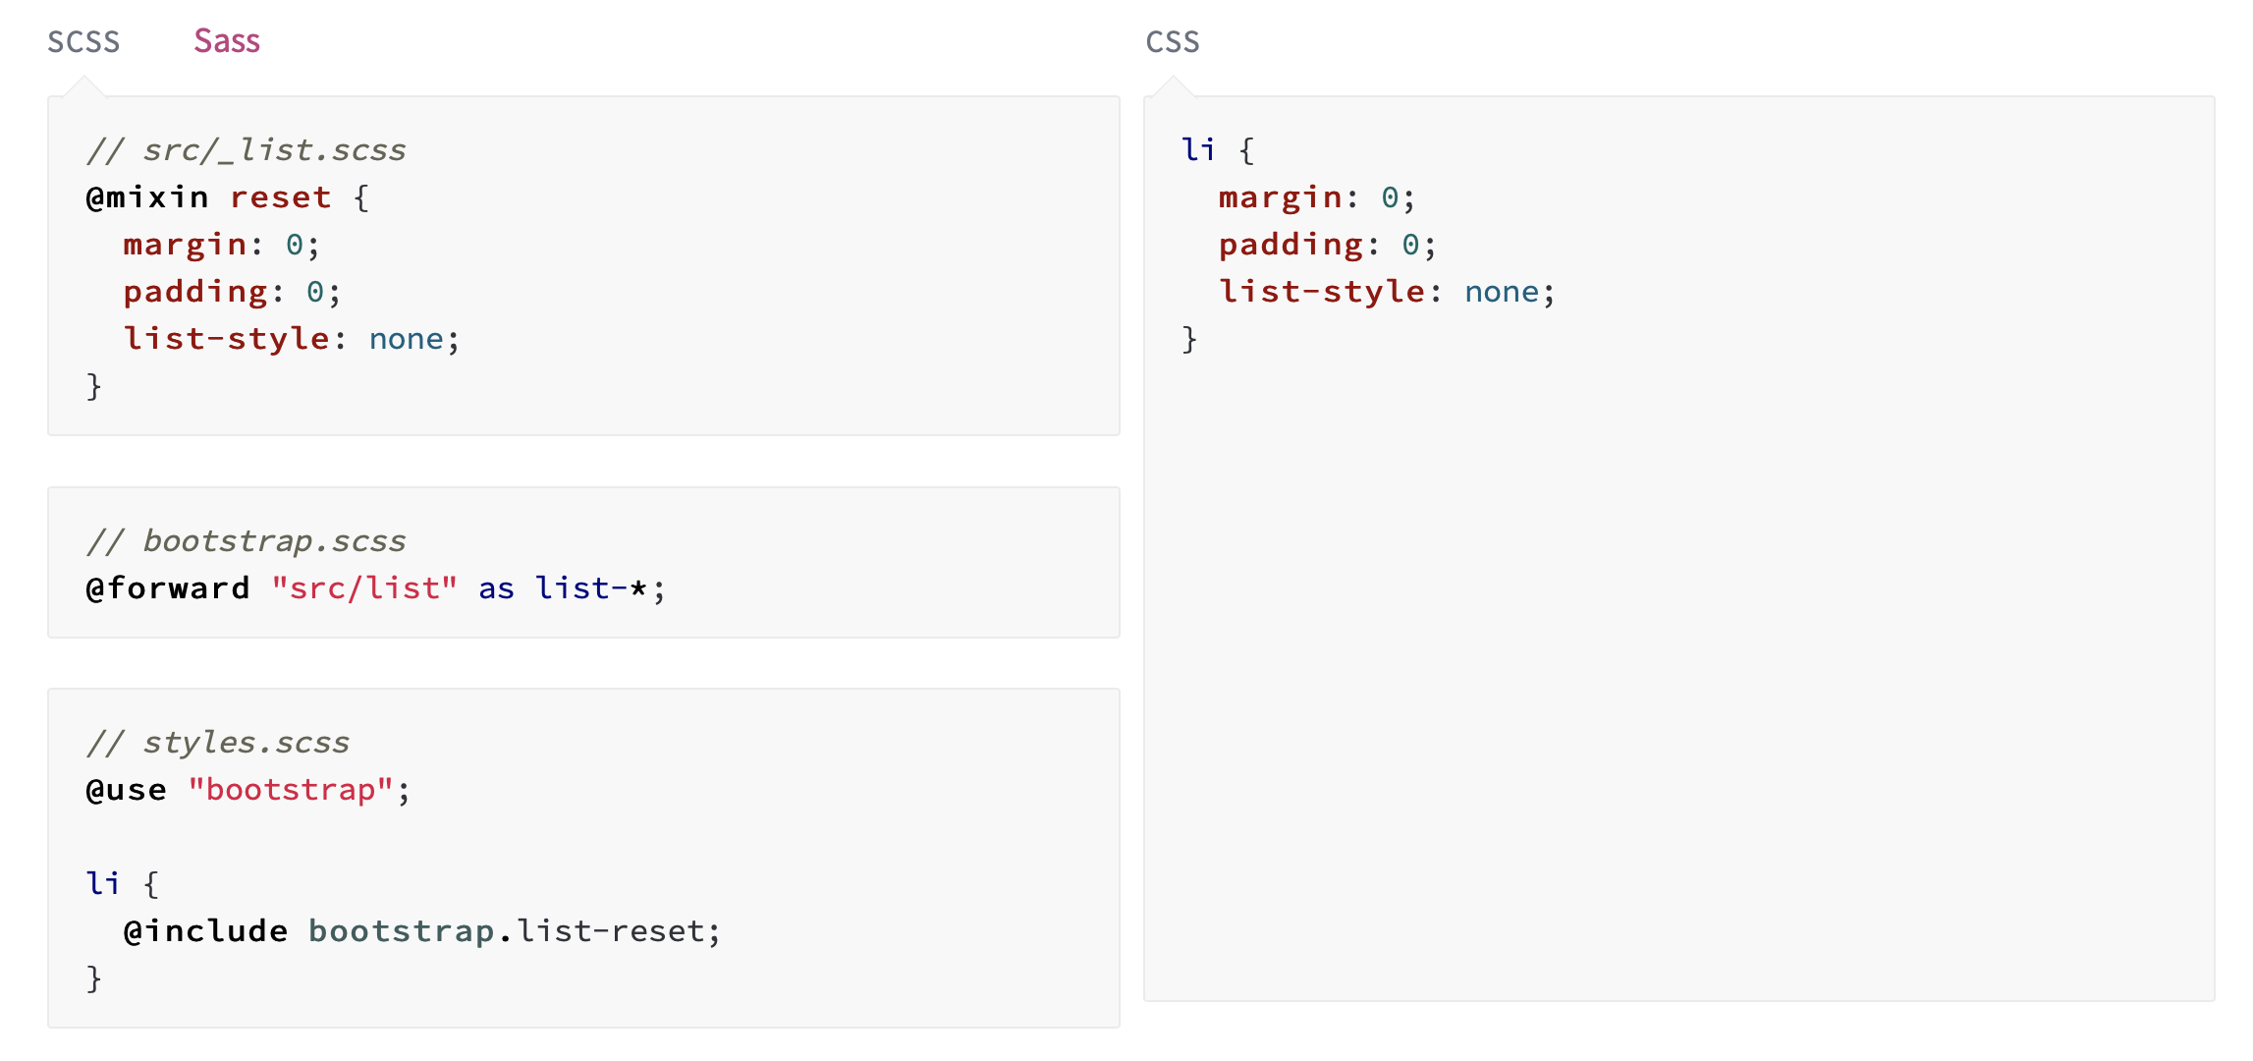
https://sass-lang.com/documentation/at-rules/use

Slide 13
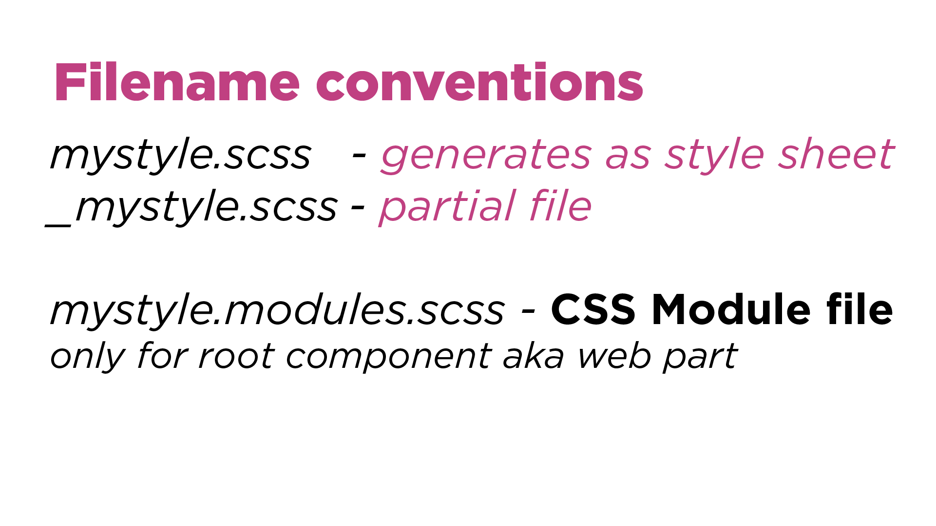

Slide 14
CSS Modules
Helps to write scoped CSS by attaching a hash to each class name
Give JavaScript Developer support
Don’t use modules in sub components -> Webpart Root, Extension Root, …
Use partials instead – Problem with resonsive design
https://github.com/css-modules/css-modules

Slide 15
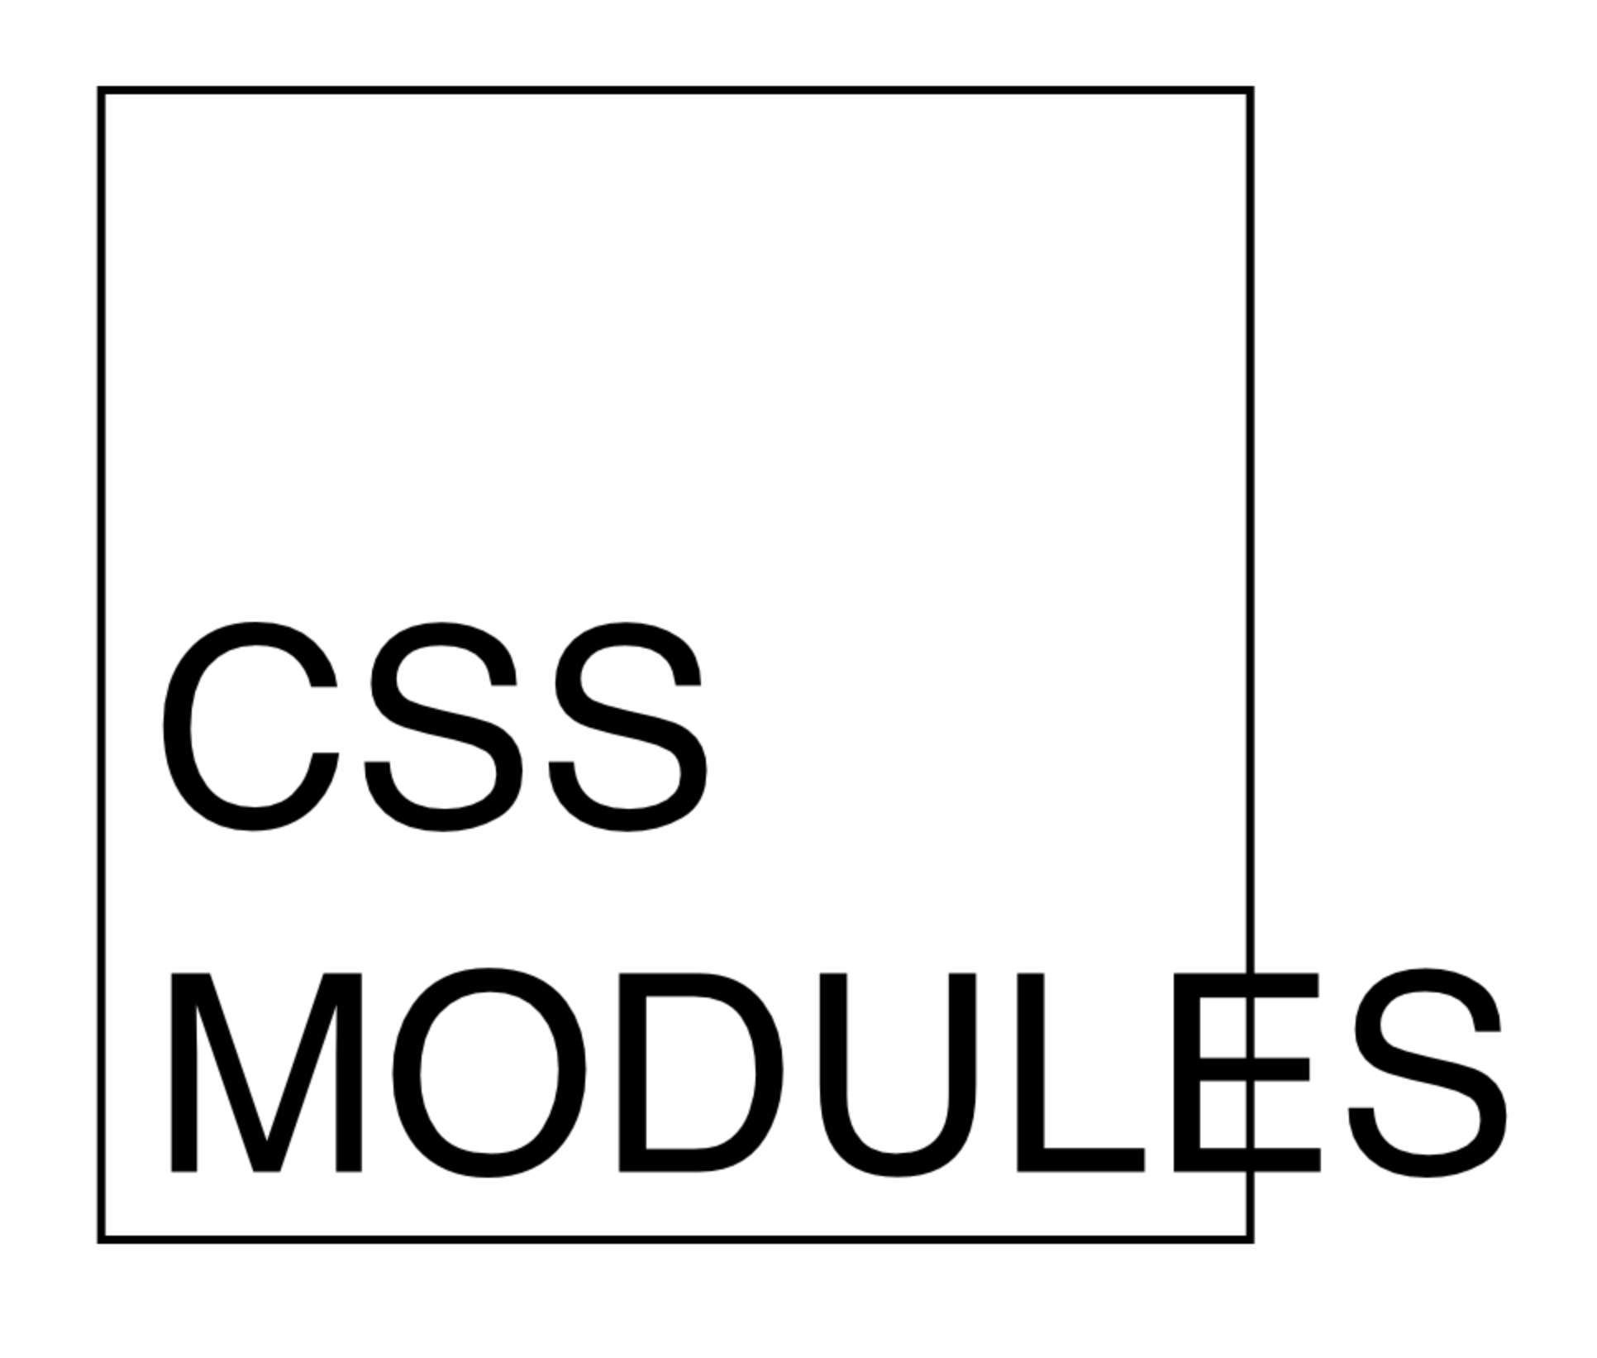
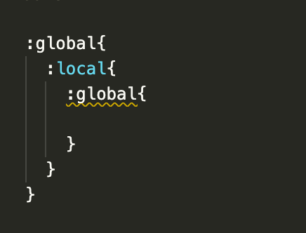
CSS Modules – Scope Helper
:global – Allows to define CSS classes at a global scope
:local – Scopes it to current component

Slide 17
Theming in Web Parts
Use theme colors in your customisation
background-color: "[theme: themeDark, default: #005a9e]";
Designing for section backgrounds using semantic slots
Support Section Background in SPFx
How to make CSS Variables work in every web part context – Stefan Bauer

Slide 18
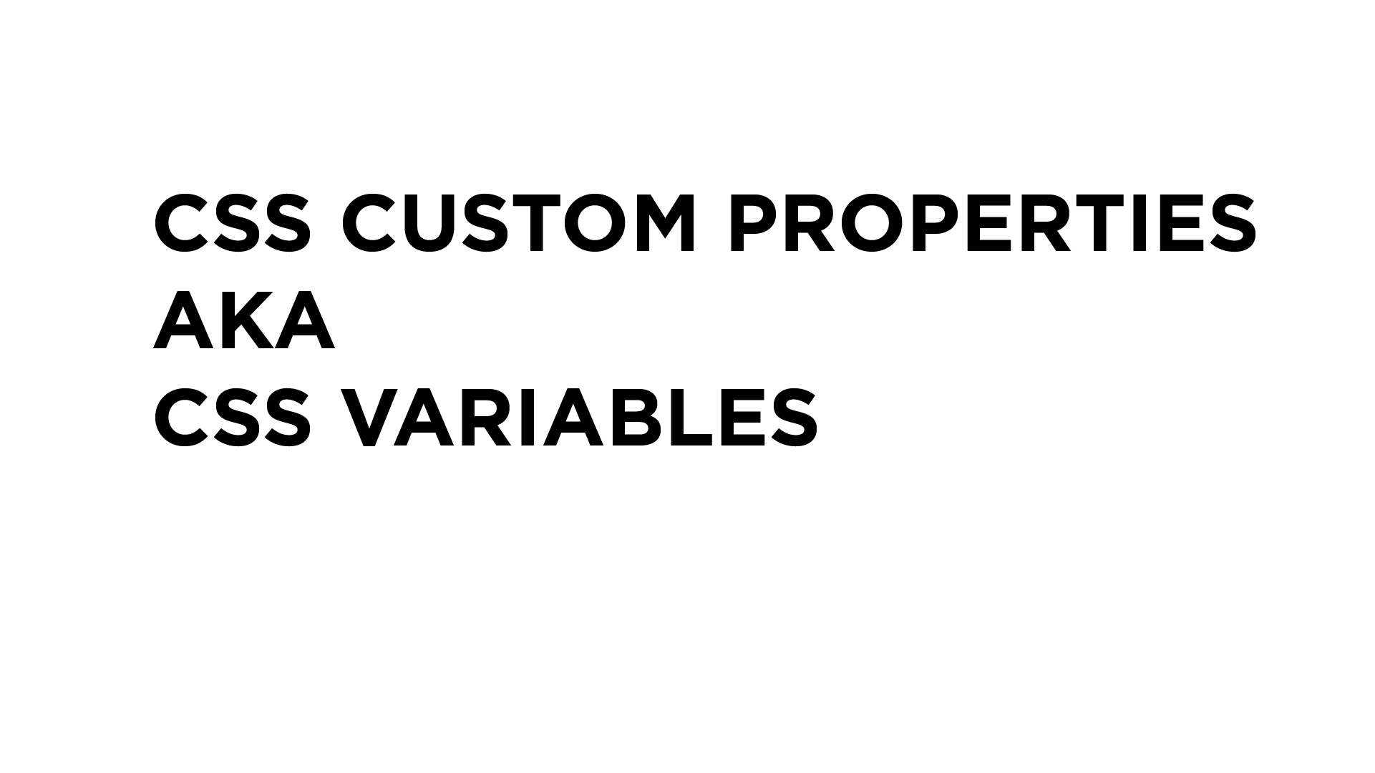
https://developer.mozilla.org/en-US/docs/Web/CSS/--*

Slide 19
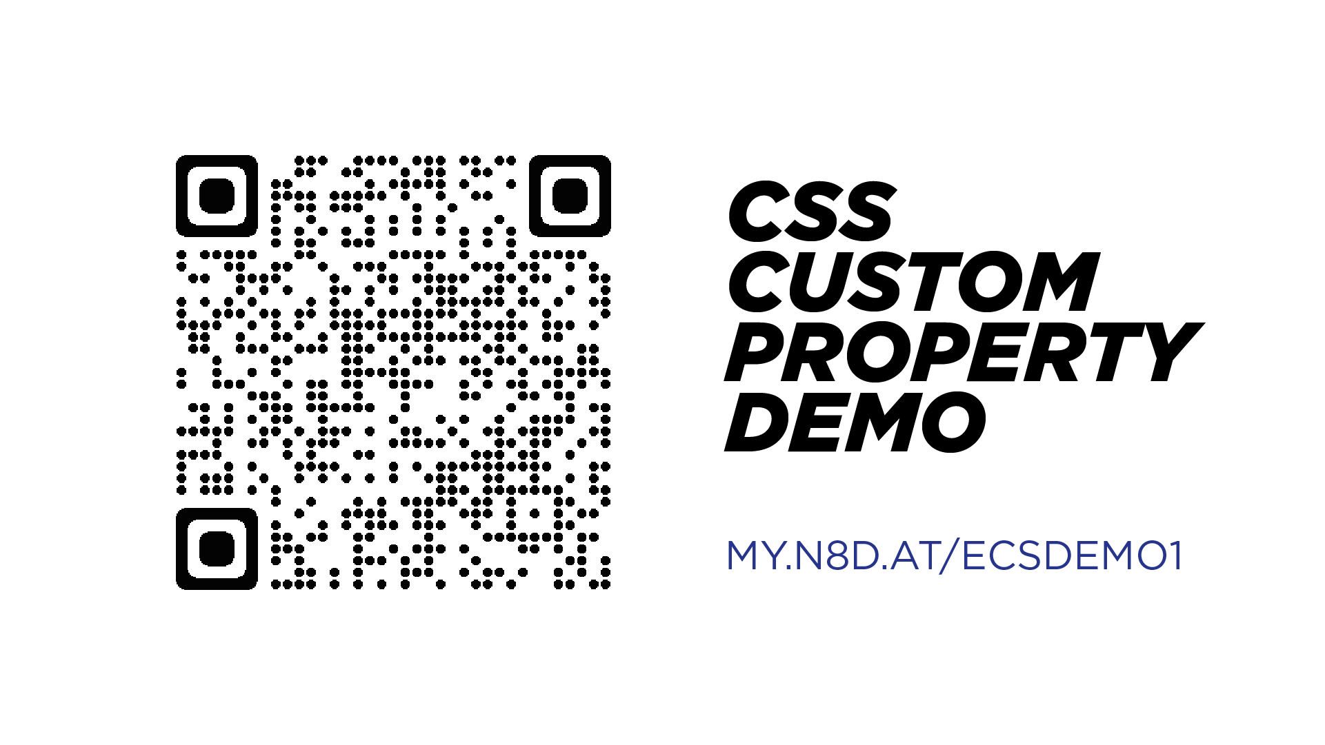

Slide 20
DEMO – Theming in SPFx
Microsoft 365 PnP assets
Notes:
5 min demo to show https://aka.ms/m365pnp – to ensure that they all are aware of that URL and available assets.

Slide 21
DEMO
hTWOo UI – open source Fluent UI Framework

Slide 22
hTWOo – Fluent UI Framework
Based on Atomic Design Methodology
HTML/CSS only framework https://lab.n8d.studio/htwoo/
npm install @n8d/htwoo-core
npm install @n8d/htwoo-react
Solutions that use hTWOo
SPFx Teams Samples https://github.com/pnp/spfx-reference-scenarios

Slide 23
More Info
Image Lazy Loading
Aspect Ratio

Slide 24


aka.ms/m365pnp

